Slide 1
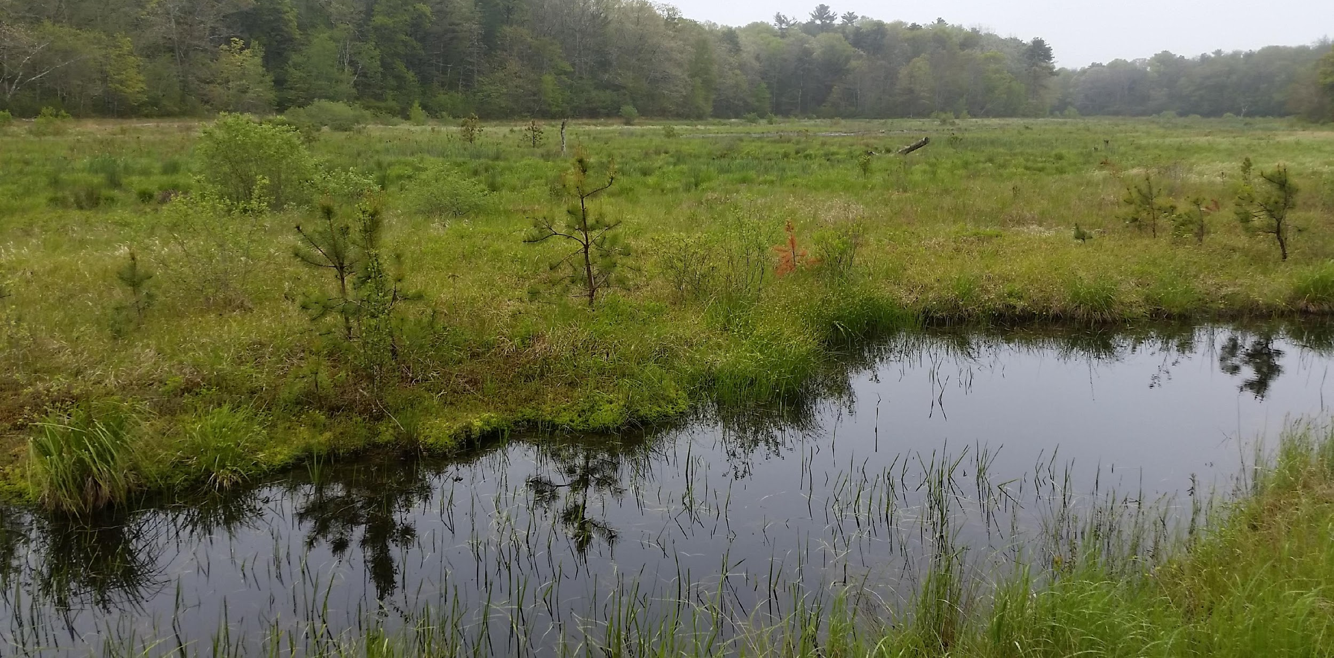

Slide 2
Introduction
2021 Conference
Committee Reports
Justice, Equity, Inclusion Committee
Emerging Professionals
Board Structure and Leadership
Coordination with SER
North America Coordinating Committee
Chapter Relations Committee
Certification for Ecological Restoration Professionals
Status of the Chapter
Membership Report
Financial Report
Looking Forward 2021
Wrap Up and Q&A
Notes:
This has been a hard year for everyone and we just want to take a moment to acknowledge the political and racial unrest that has occurred over the last year along with the global pandemic. Thank you for joining us today even during these difficult times as we share what SER-NE has accomplished this year but do want to acknowledge the unrest and injustice that have occured in our country.
Massa-adchu-es-et
Introductions: type in the chat name, affiliation, land acknowledgement; and sentence about interest in SER-NE
https://native-land.ca/
Pass to Denise: Denise also has something to add about the relationship between indegenious people and the US.
Remind folks to put questions in the chat
2021 conference June 21st-24th virtual http://www.ser2021.org/
Acknowledge we’re in a pandemic - we do some adjustments due to the pandemic but we’ve done a lot internally that we’re excited to share with you today

Slide 3
Committee reports

Slide 4
Justice, Equity and Inclusion Committee (JEI)
The Justice, Equity and Inclusion Committee engages in activities to promote anti-racism, diversity, and inclusion within the ecological restoration community in our chapter and region. The JEI committee collaborates with existing SER-NE committees to support community outreach and engagement that promotes committee goals.
Coming Soon…...
Survey
Potential Programs
Reading Group / Resources?
Education & Outreach
Anti-racism workshops?
Seminars / Webinars / Podcasts?
Notes:
Marlyse
The Justice, Equity and Inclusion Committee, which we refer to shorthand as JEI is a new committee so this is the first time you are hearing about it in an annual meeting.
Following the events of spring 2020, much like most of society, the board was doing a lot of discussion about how we were going to help support equity and justice in our northeastern Restoration community. The board had been talking about these issues for awhile and this committee was an opportunity to bring together a lot of things the board was already working on, but under one roof. In 2020 we formally added the JEI committee to our bi-laws with the wording found on the slide:
The Justice, Equity and Inclusion Committee engages in activities to promote anti-racism, diversity, and inclusion within the ecological restoration community in our chapter and region. The JEI committee collaborates with existing SER-NE committees to support community outreach and engagement that promotes committee goals.
That second sentence is key. The JEI committee is working across and with most to all of the other committees, we have representatives from every committee working on these initiatives.
Since we are in early days we have been focusing on self-assessment, goal setting and information gathering. We acknowledge that the conservation and restoration realm has some problematic history and one of our primary goals is to make SER-NE a safe and welcoming place for all folks in the field, but with attention to groups that have been historically marginalized or excluded from the community.
One of the first things we tried to do was set some goals for increasing the diversity of our membership, and in this process realized we don’t have demographic information for our membership at all. So we have been working with the Communications committee on a survey that you should be getting very soon that will ask you to share some of that data with us along with asking for your opinions on what types of programming you would find most valuable. Results from this survey will help us to understand what our current diversity looks like so we can assess how to increase our diversity, and also think about our culture as an organization and the best way this committee can serve the greater SER NE community. So please keep an eye out for the survey, it is short and will be very useful for us. Thank you! Based on this you will see there are question marks next to a lot of our next steps. We are waiting on feedback from our members to see which of these are of interest and what we should prioritize.
Much of our initial work as a committee has been inward facing with a goal of expanding these activities outward. For example, we organized an anti-racism/anti-bias course for the board of directors, which we are currently in the middle of completing. Our hope is to see if we can help facilitate these types of trainings for interested members of SER-NE community as well. We have also organized a reading/discussion group for the board focused on books/content around Environmental Justice in the conservation and restoration sector. You can see two examples here on the slide, Robin Wall Kimmerer’s Braiding Sweetgrass and Carolyn Finney’s Black Faces, White Spaces. We have been talking about curating a reading list, virtual book club, or other options if there is interest from the SER community.
Other programs we are thinking about hosting webinars and other events with a focus on Environmental Justice topics, and highlighting diversity in the restoration sector. We will be looking for sponsors for some of these seminars and events, so if you or your organization would be interested in sponsoring an event please reach out to us (Danielle Perry and/or me). Remember to keep an eye out for the survey!

Slide 5
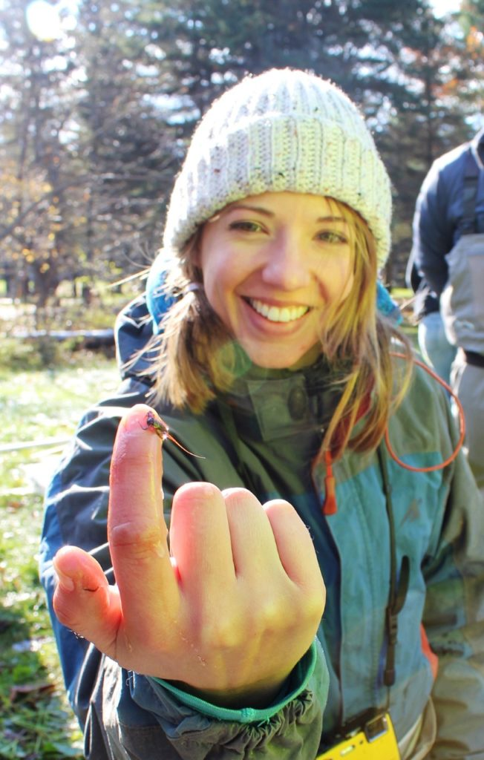
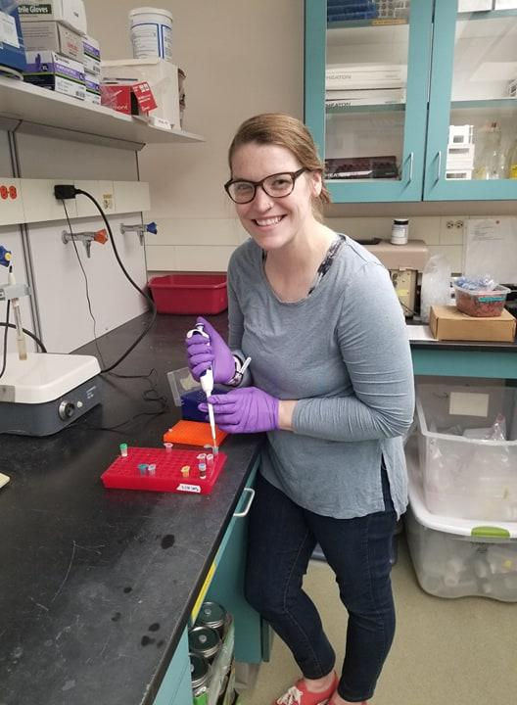
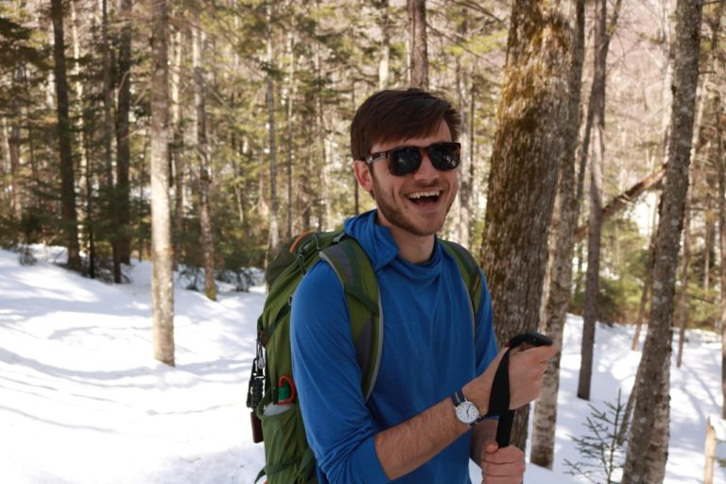
Emerging Professionals
2021 Laderman Research Grant
Application deadline: 4/9/2022
Largest ever award, thanks to
$2,000 match from SER.
Notes:
Derrick

Slide 6
2021 Board of Directors
Chair: Denise Burchsted (Keene State College)
Vice Chair: Danielle Perry (Mass Audubon / recent URI PhD graduate)
Secretary: Alexandra Evans (recent UNH PhD graduate)
Treasurer: Mike Toohill (CONECO)
Derrick Alcott (recent UMass PhD graduate), Michael Chelminski (Stantec), Stew Diemont (State University of New York - Environmental Science & Forestry), Marlyse Duguid (Yale School of the Environment), Alex Hackman (MA Department of Ecological Restoration), Megan Lung (self - also employed by Hudson River Estuary Program/NEIWPCC), Gwen Macdonald (Save the Sound / CT Fund for Environment), Michael Leff (Ecological Connections), Tim Simmons (retired, MA Heritage Program), Tom Touchet (AECOM), Naomi Valentine (SWCA)
Notes:
Denise

Slide 7
Name change
Notes:
Denise

Slide 8
Coordination with SER

Slide 9
Notes:
Mike T

Slide 10
SER International – Chapter Relations Committee
Notes:
Michael L.

Slide 11
Notes:
Mike T.

Slide 12
State of the chapter

Slide 13
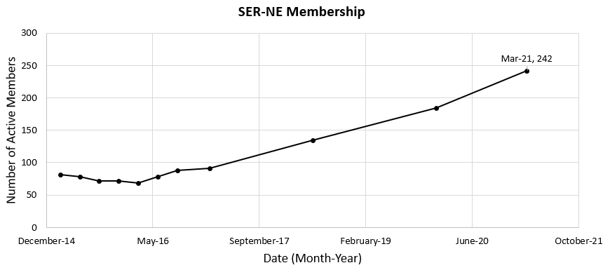
Membership Report - 242 active members as of March!
Notes:
Alexandra

Slide 14
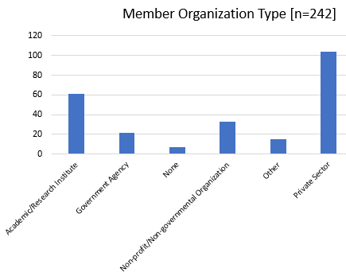
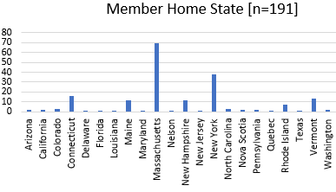
Membership Report - continued
Notes:
Alexandra

Slide 15
Notes:
Mike T

Slide 16
Looking ahead …

Slide 17
Looking ahead
SER-I 2021 world conference, 21 – 24 June
Notes:
Denise

Slide 18
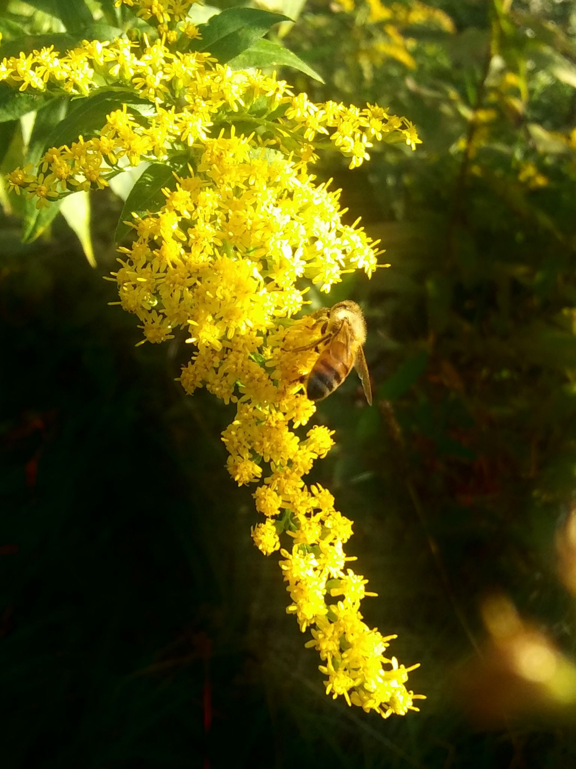
Looking ahead
SER-I 2021 world conference, 21 – 24 June
Webinar series in planning (sponsorship opportunities)
Please fill out the SER-NE survey, coming to your inbox soon!
Notes:
Denise

Slide 19
Thank you!
Members of the SER-NE board and advisors, past and present
Committee chairs
All members of SER-NE
Notes:
Board Members please stay on for a quick check in

